Slide 1

Data Mining
Presented By:
Truong Hoang Bao

Slide 2
Data, Information & knowledge
Data
- The most elementary descriptions of things, events, activities, and transactions
Information
- Organized data that has meaning and value
Knowledge
- The concept of understanding information based on recognized patterns in a way that provides insight to information
PRESENTATION – DATA MINING

Slide 3
Business Intelligence
Business Intelligence (BI) refers to applications and technologies which are used to gather, provide access to, and analyze data and information about their company operations.
Data Mining is an important part of Business Intelligence.

Slide 4
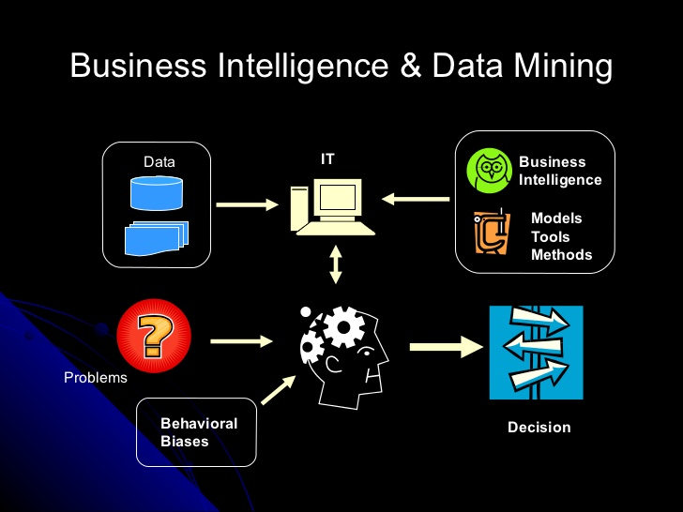

Slide 5
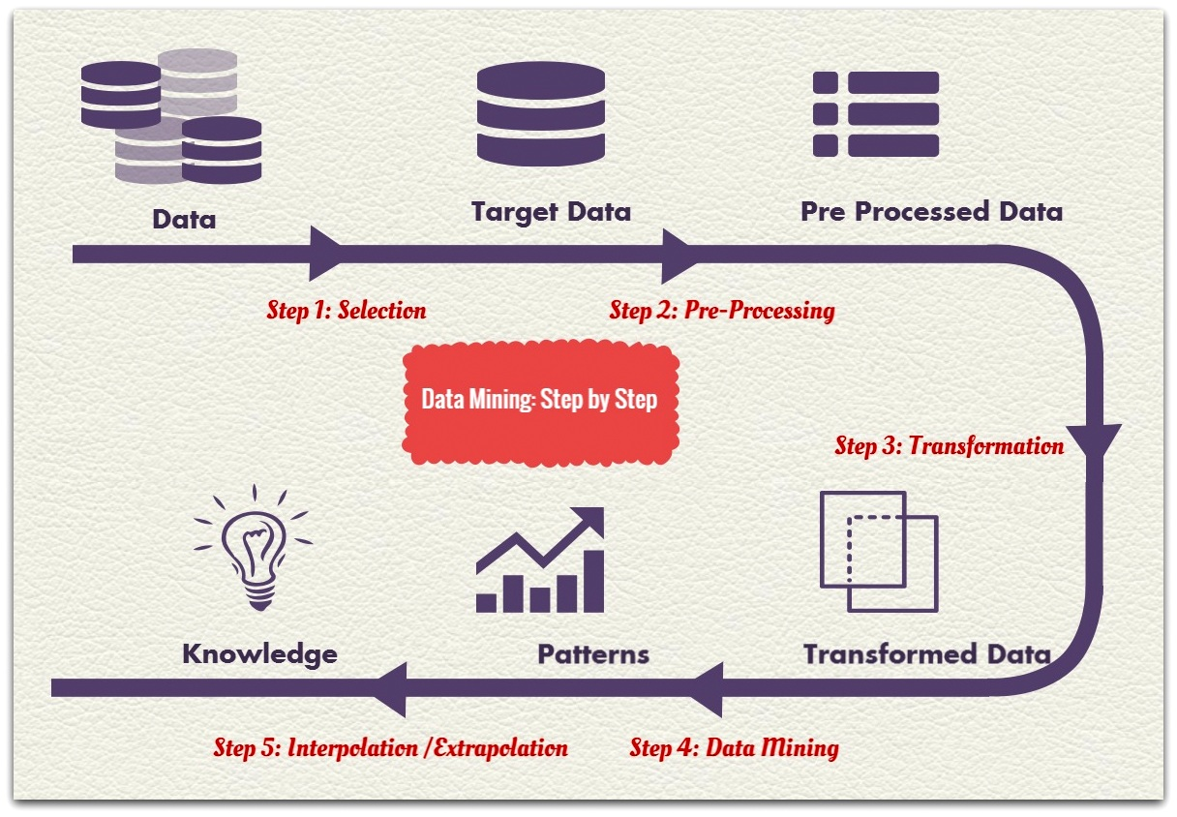
What is data mining?
The automated extraction of hidden predictive
information from (large) databases
Three key words:
Automated
Hidden
Predictive
Implicit is a statistical methodology
Data Mining lets you be proactive
Prospective rather than Retrospective

Slide 6
WHY DATA MINING?
Data, Data everywhere yet
…
I can’t find the data I need
I can’t get the data I need
I can’t understand the data I found
I can’t use the data I found

Slide 7
WHY DATA MINING?



DATA Explosion problem
drowning in data
but starving for knowledge
Data warehousing
data mining

Slide 8
Application of
Data Mining
Industry
Finance
Insurance
Telecommunication
Transport
Consumer goods
Scientific Research
Utilities
Application
Credit Card Analysis
Claims, Fraud Analysis
Call record analysis
Logistics Management
Promotion Analysis
Image, Video, Speech
Power usage analysis

Slide 9




AI products and solutions
AI platform
…………….
Innovate and accelerate with
powerful tools and services that bring AI to every developer.
AI solutions
……………
Use AI to drive digital transformation with accelerators, solutions, and practices that empower your organization.
Intelligent applications
…………………........
Experience the intelligence built into Microsoft products
and services you use everyday.
Cortana
…........
Learn how Cortana is helping you stay on top of it all so you can focus on what matters most

Slide 10
OUR MISSION
Data integration
Data selection
Data cleaning
Data transformation
Data mining
Pattern evaluation
Knowledge presentation
Steps of
Data mining?

Slide 11
OUR MISSION
Classification
Clustering
Association Rule Discovery
Sequential Pattern Discovery
Regression
Deviation Detection
DATA MINING
TASKS…

Slide 12
SOLUTION:
Given a collection of records (training set )
Each record contains a set of attributes, one of the attributes is the class.
Find a model for class attribute as a function of the values of other attributes.
GOAL:
Previously unseen records should be assigned a class as accurately as possible.
A test set is used to determine the accuracy of the model. Usually, the given data set is divided into training and test sets, with training set used to build the model and test set used to validate it.
Classification
Definition
98%
34%

Slide 13
categorical
categorical
continuous
class
Classification
Definition
Test
Set
98%
34%
Training
Set
Learn
Classifier
Model

Slide 14
SOLUTION:
Given a set of data points, each having a set of attributes, and a similarity measure among them, find clusters such that:
Data points in one cluster are more similar to one another.
Data points in separate clusters are less similar to one another.
Clustering
Definition
98%
34%

Slide 15
Euclidean Distance Based Clustering in 3-D space.
Intracluster distances
are minimized
Intercluster distances
are maximized
Clustering
illustrating
98%
34%

Slide 16
Given a set of records each of which contain some number of items from a given collection;
Produce dependency rules which will predict occurrence of an item based on occurrences of other items.
SOLUTION:
Given a set of records each of which contain some number of items from a given collection
Produce dependency rules which will predict occurrence of an item based on occurrences of other
Association rule
Discovery
Definition
98%
34%
Rules Discovered:
{Milk} --> {Coke}
{Diaper, Milk} --> {Beer}

Slide 17
Marketing and Sales Promotion:
- Let the rule discovered be
{Bagels, … } --> {Potato Chips}
- Potato Chips as consequent => Can be used to determine what should be done to boost its sales.
- Bagels in the antecedent => Can be used to see which products would be affected if the store discontinues selling bagels.
- Bagels in antecedent and Potato chips in consequent => Can be used to see what products should be sold with Bagels to promote sale of Potato chips!
Association rule
Discovery
Application
98%
34%

Slide 18
SOLUTION:
Given is a set of objects, with each object associated with its own timeline of events, find rules that predict strong sequential dependencies among different events.
( A B ) ( C ) → ( D E )
Rules are formed by first disovering patterns. Event occurrences in the patterns are governed by timing constraints.
Sequential pattern
discovery
Definition
98%
34%
(A B) (C) (D E)
<= xg
>ng
<= ws
<= ms

Slide 19
In telecommunications alarm logs,
- (Inverter_Problem Excessive_Line_Current)
(Rectifier_Alarm) --> (Fire_Alarm)
In point-of-sale transaction sequences,
- Computer Bookstore:
(Intro_To_Visual_C) (C++_Primer) --> (Perl_for_dummies,Tcl_Tk)
- Athletic Apparel Store: (Shoes) (Racket, Racketball) --> (Sports_Jacket)
Sequential pattern
discovery
Example
98%
34%

Slide 20
Predict a value of a given continuous valued variable based on the values of other variables, assuming a linear or nonlinear model of dependency.
Greatly studied in statistics, neural network fields.
Examples:
- Predicting sales amounts of new product based on advertising expenditure.
- Predicting wind velocities as a function of temperature, humidity, air pressure, etc.
- Time series prediction of stock market indices.
REGRESSION
Definition
98%
34%

Slide 21
Detect significant deviations from normal behavior.
Applications:
- Credit Card Fraud Detection
- Network Intrusion Detection
Deviation/anomaly
detection
Definition
98%
34%

Slide 22
THANK YOU !
END OF PRESENTATION

